Slide 1

Explorative Data Analysis of Movie Trends
By :
Peter Kimani Muhia
Venue: Virtual (Google meets)

Slide 2
Objectives
To analyse movie trends, ratings, genres and revenue
To determine the most lucrative movies and markets
To draw conclusions on the suggest best business venture in the movies industry.

Slide 3
Overview
Background
Focus
Microsoft has observed the growing trend of major companies venturing into the realm of original video content, and they are eager to join the ranks. With aspirations of establishing their own movie studio, they embark on a journey into the world of filmmaking, despite their limited experience in the field.
This project is centered around the exploration of the most successful film genres currently dominating the box office. The objective is to extract practical insights that will empower the leadership of Microsoft's budding movie studio in determining the optimal genres for their future film creations.

Slide 4
Data Source
The analysis included three datasets: bom.movie_gross.csv, title.basics.csv, and title.ratings.csv. bom.movie_gross.csv was about gross earnings in both domestic and foreign market, title.basics.csv contained title year, runtime and genre while title.ratings.csv contained data on average rating and number of votes

Slide 5
Results
The mean for foreign gross is 75,057,040 while that of domestic gross is 45,669,750.however, the standard deviations are big (137,529,400 and 76,375,490 respectively) implying that there are extreme numbers in the data set. Indeed, the minimum foreign gross is 600 while the maximum is 960,500,000, a huge variaion! Similarly, the minimum in domestic gross is 400 while the maximum is 700,100,000. This implies that the mean cannot be efficient measure. Categorizing the data and getting the percentage would be more sensible.

Slide 6
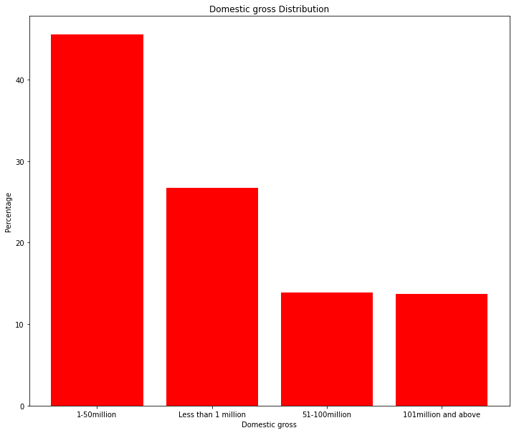
Domestic Gross Earning Distribution

Slide 7
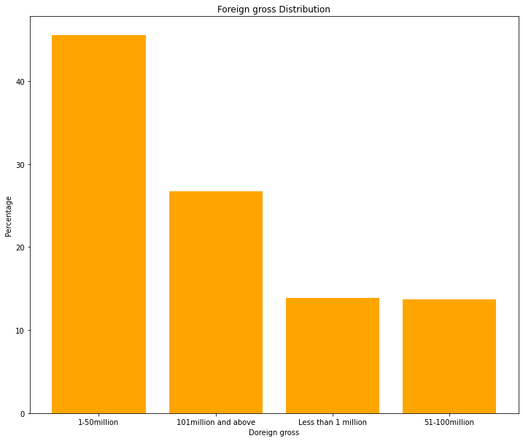
Foreign Gross Earning The gross earning for most movies are between 1 to 50 million in both domestic and foreign markets. However, investments that draw over 100 million will target more of foreign than domestic market where movies with this earnings command over 25% of the market.

Slide 8
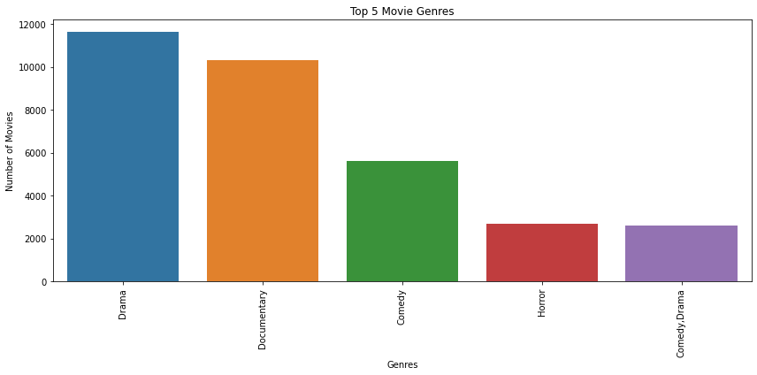
TOP FIVE MOVIES GENRES

Slide 9
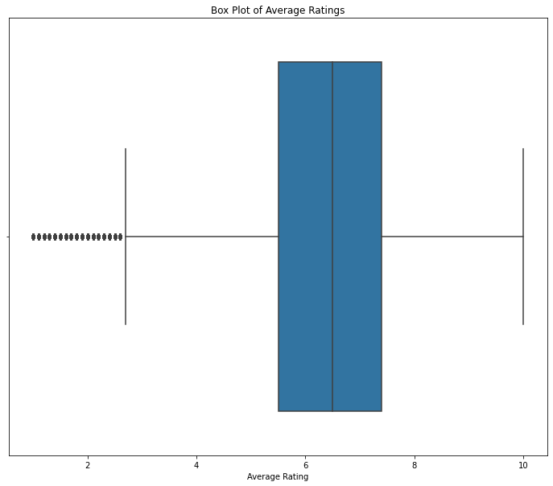
AVERAGE RATINGS

Slide 10
Conclusion and Recommendations…
Conclusion
This analysis provided insights into the movie dataset, that inclueds identifying the, high earning market segment i.e. foreign and domestic, share of earnings, popular genres and their association with the number of votes. Visualization was included to help in understanding the distribution of movie genres and their popularity necessary to draw informed conclusion. The analysis of the data revealed that microsoft managers who would like to venture into movies industry should put their focus on drama, documentary and comedy. Foreign market has higher earning than domestic market. number of votes for a movie determines its rating and consequent viewership
Recommendations
First, the management should make a decision on scale of investment they would like to put in the movie industry. For trials, they can focus on domestic industry to learn a few loops in the business since the market is small and has low earning requiring least investment. This means the risk exposure is minimal. However, if the company want to go full scale with huge investment foreign market offers great opportunity.
Second, on the movies genre the team would like to invest in, drama, documentaries and comedy are the most promising since they command a huge market.
Third, as a strategy to monitor the market, either average ratngs or number of votes gives a guide on how a certain movie is performaning in the market.

Slide 11
Thank you!

